Slide 1
Dashboard Draft
2021/01/19

Slide 2
Table of Contents
Annual Statistics
Slides 3 to 7 – member demographics
Slides 8 & 10 – work volume/income (new slide included)
Slides 11 & 12 – Finances
Slide 13 & 14 – CPD Statistics
Slides 15 to 19 – Insurance Claims
Slide 20 – SRD Results
Slides 21 to 24 – Complaints/Inquiries
In-Year Information
Slides 25 & 26 PSRI Statistics
Slide 27 & 28 – SRD
Slide 29 – AERC
Slide 30 – Council
Slides 31 to 33 – AOLS Website Usage
Slides 34 to 60 – Committee Activity

Slide 3
Member Statistics

Slide 4
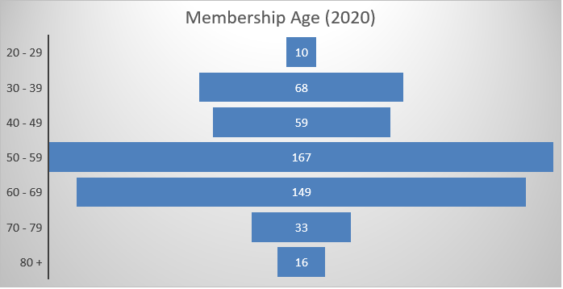
Membership Demographics

Slide 5
Member Statistics

Slide 6
Member Statistics

Slide 7
Member Statistics

Slide 8
Member Statistics - Work Volume Indicators

Slide 9
Member Statistics - Work Volume Indicators
Condominium Plans | 287 | 273 | 318 | 300 | 341 | 315 | 308
Plans of Subdivision | 371 | 341 | 325 | 404 | 367 | 392 | 323
Expropriation Plans | 638 | 499 | 427 | 272 | 280 | 482 | 347
Plans-General | 6447 | 754 | 40 | 74 | 75 | 78 | 94
Reference Plans | 12075 | 11324 | 10998 | 11076 | 11209 | 11581 | 11054
Total | 19818 | 13191 | 12108 | 12126 | 12272 | 12848 | 12126

Slide 10
Member Statistics
Raw Data was unavailable and multiple medians had to be used to calculate this point, which may not be correct
No salary survey completed since 2018

Slide 11
AOLS Finances

Slide 12
Discipline Costs

Slide 13
CPD
3 Year Cycle End for most members

Slide 14
CPD – AOLS Training Offered

Slide 15
Professional Liability Insurance

Slide 16
High Level Breakdown of Insurance Claims by Numbers
(From 2017 to November 20, 2020 – 218 claims)

Slide 17
Error Types
Errors were broken down into the following categories
Office Error Calculation – this was used when it was clear that error flowed from a calculation error in the office
Office Error Check – this was used where it was obvious that the error should have been caught by a check but was not used when it was a calculation error (e.g. wrong lot number on plan, wrong unit number on condo plan)
Office Error Search – this was used where there was a lack of information that would have been available with a reasonable search (e.g. title search, municipal by-law search)
Field Error – this was used where there was admission that the error was in the field (even though it should have been caught by a check)
Communication - used where internal and/or external communications caused the error (e.g. wrong version used)
No observable error
Other – errors not covered above
Unknown – the surveyor did not provide enough information to derive a source of error

Slide 18
Construction Breakdown of Error Types by Numbers
(From 2017 to November 20, 2020 – 104 claims)

Slide 19
Legal Breakdown of Error Types by Numbers
(From 2017 to November 20, 2020 – 47 claims)

Slide 20
Comprehensive Survey Reviews
Number of Files reviewed
Number of Firms reviewed
Top Five Scores
Field Procedures (field notes)
Total Score
Research
Reports to Clients
Measurement Verification
Best Evidence of Boundary

Slide 21
Notes:
Turning now to Complaints, the total number of formal complaints we received last year was 21, which was 7 more than 2018, and 7 above the average over the past 10 years. Again, I do not have any statistical information which would allow me to analyze why there was a slight spike in complaints over the past year, but I can comment on the fact that most of these seem to derive from deficiencies in members’ research, communication issues, and contractual issues between the surveyor and the client. 17 of the complaints received in 2019 were from members of the public, 1 was from an OLS, and three were submitted by the Registrar.

Slide 22
Complaints Breakdown
Complaints Committee 2018 2019 2020 2021 2022
Total complaints: | 14 | 21 | 30
Nature of Complaints:
Sketches Issue | 1 |  | 1
Right-of-Entry | 1 | 1
Contractual – (Protracted Timeline / Communication) Incl. Client aware of the complexity of a project and the nature of fees? Includes undertaking work that is beyond the member’s resources to complete in the time agreed upon? | 6 | 5 | 5
Professional Misconduct | 3 | 2 | 9
SRD Referral | 1 | 3
Incorrect Survey? | 1 | 9 | 9
CAD File – Grid vs. Ground | 1
Incompetence |  |  | 3
Not Truly a complaint ( Who is responsible ?) |  | 1
Disgruntled complainant seeking additional information on old complaint |  |  | 5
Complaint initiated by another OLS |  |  | 4

Slide 23
Complaints Breakdown Continued
21 of the 30 complaints are complete and 1 of those completed files was referred to Council
Some of the above complaints do not readily fit within one category. Professional Misconduct and Incorrect Survey tend to be catch-all’s.
2 of the professional misconduct complaints were initiated by other members.
2 of the incompetence complaints relate to water boundaries & applicable common law principles
Complaints under the heading “Incorrect Survey” often involve a third party who was affected by the survey and is refuting its accuracy or correctness
Professional Misconduct included issues such as conflicts of interest, allegations of dishonesty, not adhering to standards for monumentation, research and plan preparation
Average total days from Complaint to completion of file in 2020 – 95 (89.1 business days)

Slide 24
Public Inquiries

Slide 25
PSRI Statistics

Slide 26
PSRI Statistics

Slide 27
Survey Review Department Statistics
Statistics as of December 22, 2020
30 of overall firms (at the start of 2020)
Target 58 of reviews to be completed (within 12 months of start date)
8.3% of systematic reviews completed (per month)
All reviews in progress, 0 started (to Dec 22, 2020)
6 of reviews completed (to December 22, 2020)
27 reviews currently open (December 22, 2020)
6 months on average to complete the 6 reviews (from start to finish) The start date is deemed to be the date we receive the supporting material
Sticker sales this month 7,020; last month 3,310
Sticker sales YTD 40,210; Sticker sales 35,450 (2019)

Slide 28
SRD Sticker Sales

Slide 29
AERC Statistics
2020
52 Academic Evaluations completed
33 Articling students approved
  (6 Ryerson, 8 York, 2 UNB, 1 U of T, 2 Georgian College, 1 Northern College, 1 Western, 1 McMaster, 1 Waterloo, 8 internationally trained, 1 Nova Scotia Community College, 1 Lakehead University)
2.60 years average term of articles for new surveyors
13 Statutes Exams graded, 0 failures
45 Professional Exams given (As of November 27, 2020)

Slide 30
Council
Number of By-laws approved - 2
Number of Bulletins approved – 1
Number of Regulations approved – 0
Discipline
Number of referrals | Number to Mediation | Number to Discipline | Number Dismissed
3 | 2 | 1 | 0
Council Activity
Policy Related | Planning/ Forward thinking | Statutory Process related | Information Items | Total
3 | 1 | 1 | 3 | 8 | Jan Meeting
4 |  | 3 | 3 | 10 | Feb Meeting
 |  | 1 | 1 | 2 | March Meeting
3 | 3 | 2 | 2 | 10 | April Meeting
5 |  | 2 | 3 | 10 | June Meeting
1 | 2 | 2 | 2 | 7 | July Meeting
1 |  | 2 | 3 | 6 | Sept Meeting
3 | 1 | 2 | 3 | 9 | Oct Meeting
1 |  |  |  | 1 | Dec Meeting
21 | 7 | 15 | 20 | 62 | Total
34% | 11% | 24% | 32% | 100%

Slide 31
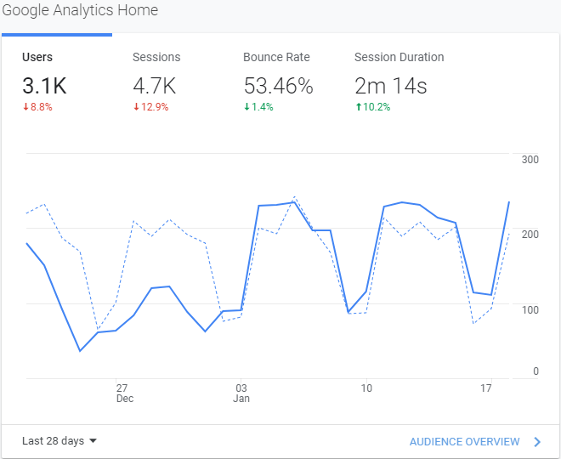
AOLS Website

Slide 32
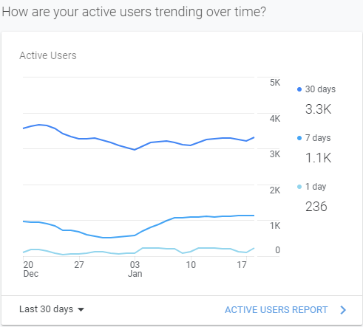
AOLS Website

Slide 33
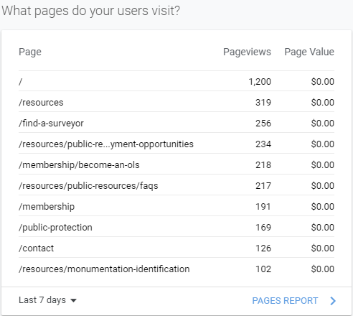
AOLS Website

Slide 34
Committee/Task Force Summary
Committee/Task Force | Status | Council Attention Req'd
Fees Mediation
Government Relations
Legislation and Regulations TF |  | seeking reg approval
Nominating
Registration
Fees for Field Notes TF
Complaints
Discipline
Monument Protection
LRO Task Force
Professional Standards
Province-Wide SRI Committee
Survey Review Department
Underground Utilities
AERC |  | renew appointments
Continuing Education
CPD Audit
Geomatics Recruitment & Liaison
Expanded Profession TF
Public Awareness
University & College Liaison |  | appoint chair
Website Maintenance
Municipal Surveyors
AGM
Archival and Historical
Insurance Advisory
Legend
On Track
Somewhat on Track
Needs Attention
Inactive

Slide 35
Statutory Committee - Fees Mediation Committee
Key Commitments/Expectations
Procedural Manual reviewed regularly
Decisions or Interim decisions issued within 60 days of parties delivering final submissions
Annual reporting completed on (likely by Registrar):
  Number of Mediations
  Number of Arbitrations
  Average time to resolve fee complaints
Progress
One case has been resolved
The second case appears to have been resolved between both parties. The Presiding Officer (Brent) continues to follow up to ensure finalization that this happens.
Mediation training complete for most members
Other Comments
Working on update to manual
Status: (e.g. On-track)
On track

Slide 36
Non statutory Committee - Government Relations Committee
Key Commitments/Expectations
Meetings held with Key ministries: MNRF, MGCS and MTO annually
Issues requiring attention addressed
Progress
ED met with three government leads to discuss survey reviews
ED sat on interview panel with MNRF
Letters sent out to all municipalities
Committee has not met
ED met with Deputy Minister MNRF
Other Comments
Status: (e.g. On-track)
Inactive

Slide 37
Non-Statutory Committee - Legislation and Regulations Task Force
Key Commitments/Expectations
Committee is still waiting for the completed “Black-Corner Copies”
Determine where to derive suitable and progressive legislative change
Determine Suitable Act Changes
Progress
Act Changes have passed final reading
Final review of regulation changes finished after being returned by MNRF legal team – looking for Council approval
Other Comments
Status: (e.g. On-track, behind schedule)
On Track

Slide 38
Statutory Committee - Nominating Committee
Key Commitments/Expectations
By August 31st elect a chair from its members
By November 15th send the Registrar a slate of candidates nominated for Council
Give consideration to diversity in their selections
Progress
Dan Dzaldov has been elected Chair
First Notice published in the In Sight on Aug. 14
The last meeting took place on Sept. 9
Nomination report submitted to the Registrar on September 9
Other Comments
Status: (e.g. On-track, behind schedule)
On Track

Slide 39
Statutory Committee - Registration Committee
Key Commitments/Expectations
Procedural Manual reviewed regularly
Decisions or Interim decisions issued within 60 days of applications to the Committee.
Annual reporting completed on (likely by Registrar):
Number and type of hearings
Average time to resolve application
Progress
Applications usually take 1-2 weeks to resolve. These have been done most recently via email
Usually 1-2 applications per year
Most current applications have been requests for OLS' to be able to have one OLS to operate more than 1 office under 1 C of A
Other Comments
No hearings have been requested
Status: (e.g. On-track, behind schedule)
Inactive

Slide 40
Non-Statutory Committee - Fair Fees for Field Notes Task Force
Key Commitments/Expectations
Report considering the “reasonable fees” for survey records.
Progress
Prepared a final report to Council advising of the average fees being paid for field notes
Drafted a bulletin for Council establishing maximum pricing for survey record searches. This bulletin was passed as Bulletin 2020-01, (Pricing of Field Notes and Survey Records)
Other Comments
The Task Force will be performing another survey of the membership in 2021
Status: (e.g. On-track, behind schedule)
Inactive

Slide 41
Statutory Committee - Complaints Committee
Key Commitments/Expectations
Procedural Manual reviewed regularly
Disposed of complaints within 90 days after the day the complaint was filed {Surveyors Act s. 23(3)(b)}
Progress
In 2020 we had 29 formal complaints. 11 of these 29 complaints were initiated by 3 complainants (we average 17 complaints per year)
  A temporary Complaints Committee dealt with 4 of these files.
The statutory Committee currently has 10 files in progress
The Committee continues work on amendments to its manual.
We’re still planning to make amendments regarding how we deal with complaints against former members. (Workload has interfered)
Other Comments
Need additional members
Need to find a way of balancing workload, particularly in advance of meetings and away from the Chair
Need to find a better way of using the AOLS portal
Status: (e.g. On-track, behind schedule)
On Track

Slide 42
Statutory Committee - Discipline Committee
Key Commitments/Expectations
Procedural Manual reviewed regularly
Hearings scheduled within 60 days
Written orders and reasons issued after hearing within 30 days
Annual reporting completed on:
  % of Joint submissions
  % of decisions with appeals
  # of days to schedule a hearing after Council referral (expected 60 days)
  # of days to deliver written Order and Reasons after hearing (expected 30 days)
Progress
3 hearings held to date this year (all ended with joint submissions). 1 hearing was held using online mechanisms.
Decisions were posted to the website and In Sight.
All decisions have been published in the OPS magazine and one will be published
On November 12 & 13, 2020, 10 members of the Discipline Committee completed both the basic and advanced modules of the Discipline Orientation Workshop offered by the Health Profession Regulators of Ontario (HPRO). It is expected that the remaining 10 DC members will complete that training in Spring 2021
Other Comments
Status: (e.g. On-track, behind schedule)
On Track

Slide 43
Non-Statutory Committee - Monument Protection Committee
Key Commitments/Expectations
Provide Public Awareness related to monument protection
Consider Deferred Monumentation
Progress
Marketed the monumentation protection video prepared last year
The Committee did not meet for most of the year
Other Comments
Reconsideration of deferred monumentation.
Status: (e.g. On-track, behind schedule)
Needs Attention – yet to consider deferred monumentation

Slide 44
Non-Statutory Committee - LRO Task Force
Key Commitments/Expectations
Work with members and MGCS to address issues associated with the closure of the LRO counter service
Progress
Reviewed results of member survey
Met 4 times with MGCS officials
Have noted issues which have been corrected
Testing OnLand and related services
Sent out another online survey to the membership
Other Comments
Next meeting with MGCS staff planned for February 1st
Status: (e.g. On-track, behind schedule)
On Track

Slide 45
Non-Statutory Committee - Professional Standards Committee
Key Commitments/Expectations
Title Searching Guide
Field Note Standards and Party Chief Seminar
Practice Manual
Office Calculations and Drafting Seminar
Professional Oversight of Technical and Remote Workers in a Virtual Environment
Appropriate Research of Survey Records
Progress
Title Searching Cybrary established (in partnership with Anne Cole and Izaak deRijcke (Four Point Learning)).
Field Notes and Party Chief Seminar developed with CEC.
Checklists for various types of survey projects.
Updates to Practice Manual.
Office Calculations and Drafting Seminar outline prepared
Document posted for Considerations for Professional Oversight in a virtual environment (Technical and Remote Workers).
Appropriate Firm Survey Records Research for Legal Surveys guidelines started.
Schedule 28 – Survey Act update, definitions wording review and update.
Survey Business Practices Checklist started.
Other Comments
Survey Business Practices Checklist and Survey Record Searching guidelines
Other new activities to be determined by committee, Executive Director, SRD Manager and/or AOLS Council.
Status: On-track and under budget!

Slide 46
Non-Statutory Committee - Province Wide SRI Committee
Key Commitments/Expectations
Create new Terms of Reference
Support Legislation and Regulations Task Force in creating regulations
Ensure Data Administrator is on-track
Ensure members are using the system
Progress
Continued to guide the development of the Provincial Survey Records Index (PSRI) with some enhancements:
  Undockable plan views to allow better views of plans when adding records
  Inclusion of “&” in records
  Allowed linking multiple file types to records
  Removal of “all” when searching for concessions or plans and removed searching limit as a result
  Ability to clone record attributes to save data entry
For the 2020 calendar year –
  490,427 new records were added to the PSRI
  27,604 record searches were performed
  64 error observations were recorded
  203 firms have credentials, but many have not been actively using the system
Other Comments
Addressing processes once the regulation requiring mandatory use is passed
Status: On Track

Slide 47
Non-Statutory Committee - Survey Review Department Committee
Key Commitments/Expectations
Implement reviews on construction surveys
Implement reviews for C of R members
Redesign Master Tabular Report
Generate Summary Statistics for historical reviews
Progress
Policy changes to initiate reviews for construction projects and for registered members (starting with a self assessment form)
Reviewed all post-review surveys
Updated the Point system for reviews
Summarized data for the last five years to understand the most serious issues feed the new Dashboard
Considered risks in a special workshop
Recommended an increase in sticker fees to maintain a balanced budget
Enabled the use of virtual stickers (i.e. controlled numbers instead of mylar stickers)
Other Comments
Consolidating and updating the SRD Practice Manual
Moving forward with review of registered members and of construction projects
Status: On-track

Slide 48
Non-Statutory Committee - Underground Utilities Committee
Key Commitments/Expectations
Inform membership of industry developments
Craft a model utility survey product for AOLS members conforming to regs
Create a proposed set of products for different purposes
Progress
Reviewed new items in CSA S250:20 revised mapping/survey standard for OPS
Article drafted on CSA S250:20 for OPS
Purchased copy of CSA S250:20 for AOLS
Reviewed draft plan/profile of UG survey
Reviewed SABUR proposal for three products
Updated document – 50% complete
Other Comments
New Chair in July
Met: July 28, 2020, Sept 14, 2020, Dec 1, 2020, January 12, 2021
Status: (e.g. On-track, behind schedule)
On track

Slide 49
Statutory Committee - Academic and Experience Requirements Committee
Key Commitments/Expectations
Procedural Manual reviewed regularly
Academic Evaluations completed
Statutes and Professional Exams held and evaluated
Policies considered, particularly in response to requests from the Office of the Fairness Commissioner
Progress
Committee is meeting regularly and achieving required outcomes in terms of evaluations, exams and articling approvals
The committee developed a strategy for exams to be moved to an online provider. This will include statutes and professional exams. Oral exams will be conducted via video conferencing technology.
Over 40 online professional exams were completed successfully in late 2020
Other Comments
With the heavy lifting of moving exams online now behind the committee, focus will now turn to deferred priorities such as exam question review and committee policy reviews & updates.
Status: (e.g. On-track, behind schedule)
On Track

Slide 50
Non-Statutory Committee - Continuing Education Committee
Key Commitments/Expectations
Consider the educational needs of the members and set up CPD opportunities
Provide a minimum of 12 hours Formal and 12 hours Professional a year through AOLS presentations or sanctioned events.
Progress
The Committee met on eight occasions this year
Party Chief Seminar in December
  Party Chief Revenue $12,073.25
  Party Chief Expense $10,117.35
  Profit $1, 955.90
Working with the Professional Standards Committee on checklists
Moved CPD from office staff to GeoEd platform
Initiation of a CPD Audit Committee and first audit in June
Working with the membership on the use and content of the AOLS website
Other Comments
Continuing to Provide adequate Content during COVID-19
Training on construction layout to lessen Liability Claims
Status: (e.g. On-track, behind schedule)
On Track

Slide 51
Non-Statutory Committee - CPD Audit Committee
Key Commitments/Expectations
Perform a detailed audit of CPD for 5% of members annually
Annually review their audit processes
Share results of the audit with Council
Progress
Developed processes, procedures and policies for audits
Reviewed CPD entries for 5% of members. The large majority of entries reviewed were appropriate. Entering more than 30 hours per cycle continues to be concern
The Registrar asked the Committee to provide their input to two questions in relationship to a member’s CPD hour submission: Do the claimed hours appear to fall into the respective requirements for satisfying their professional and formal hours respectively; and Do the hours that satisfy the two categories fulfill the required amount of CPD for a practicing member? If not, what would be the total time allocated to the CPD claimed.
Other Comments
Refine instructions to and expectation of members
Add details to the Terms of Reference
The Committee will meet as a group on January 21 to discuss the questions above and the member’s CPD hour submission.
Status: (e.g. On-track, behind schedule)
On Track

Slide 52
Non-Statutory Committee - Geomatics Recruitment & Liaison Committee
Key Commitments/Expectations
Provide outreach to organizations that can help interest students in considering surveying as a career (e.g. high schools, career days, teacher events)
Provide material to surveyors to assist them in providing outreach as previously noted
Progress
Working with York to develop a recruitment video for distribution to students
Assisted with setting up SHSM surveying course training (delayed due to COVID-19)
Maintain contact list for school presentations
Created promotional material for Surveyors Day
Have completed virtual reality applications including the use of a digital sand box and demonstrating 3D scans
Jointly sponsored “Get Kids into Survey” (https://www.getkidsintosurvey.com/)
Working with UNB, Loyalist, York on recruitment efforts with Ontario High Schools
Other Comments
Their normal work has been significantly impacted by COVID-19 (e.g. conferences cancelled, and schools closed)
Status: (e.g. On-track, behind schedule)
Somewhat On Track

Slide 53
Non-Statutory Committee - Expanded Profession Task Force
Key Commitments/Expectations
Support the SRD Committee in developing reviews for CofR members
Support AERC in the development of resources for applicants trying to become CofR members
Develop a business case to move from CofR to a licensed requirement to practice in Geodesy, Photogrammetry, Hydrography and Geographic Information Management
Progress
Two working groups tasked with various action items
Task Force has prepared and recorded a presentation for the 2021 Virtual AGM
Task Force will re-convene post AGM to discuss outcome of presentation
Interim Action Items underway
Other Comments
Awaiting the outcome of the 2021 AGM presentation to determine next meeting and Action Items
Status: (e.g. On-track, behind schedule)
On Track

Slide 54
Non-Statutory Committee - Public Awareness Committee
Key Commitments/Expectations
Manage the AOLS Brand and marketing communications to reinforce public awareness of the geographic information professionals in Ontario
Support members in terms of promotional products and education tools for local public awareness initiatives
Represent the AOLS at external events (e.g., Realtor Quest, Science Rendezvous)
Progress
AOLS Public Advertisement – “Minimizing Risk” Ad
Support of International Women’s day
Jointly sponsored “Get Kids Into Survey”
Co-sponsoring an educational video on the activities of a surveyor – over 50 hours of footage shot, being edited.
Cadastral promotion piece as it is now being added to the educator’s page on the public side of the AOLS website.
Other Comments
Their normal work has been impacted by COVID-19 (e.g. conferences cancelled) but will continue to seek advertising opportunities in print media and online.
Status: (e.g. On-track, behind schedule)
Somewhat On Track

Slide 55
Non-Statutory Committee - University and College Liaison Committee
Key Commitments/Expectations
Maintain ongoing relationship with universities and colleges
Support university and college surveying programs as possible
Progress
COVID-19 impacted much of the normal outreach activities, however, the Committee maintained relations with Colleges and Universities providing surveying courses.
Provided regular outreach to all colleges and universities with surveying courses
Supported UNB in their transition to an Online program
Started new relationship with Seneca College
Supported the College of Geographic Science (COGS) in the creation of a new online introduction to surveying program (it is now accepting registrations)
Participated on numerous Advisory Committees
Other Comments
Increasing outreach and support for colleges
Status: (e.g. On-track, behind schedule)
On-track

Slide 56
Non-Statutory Committee - Website Maintenance Committee
Key Commitments/Expectations
Support the creation and maintenance of the AOLS website
Progress
The committee did not meet but supported behind the scenes
The New Website went live
Content was corrected and improved
A new “Find a Surveyor tool was launched”
Other Comments
Continued expansion of content
Launching a publicly available Register
Launching a more robust member directory for use by surveyors
Status: (e.g. On-track, behind schedule)
Somewhat on track

Slide 57
Non-Statutory Committee - Municipal Surveyors Committee
Key Commitments/Expectations
Provide advice to municipalities regarding surveying matters and advocate for best practices regarding municipal matters.
Increase awareness of Ontario Land Surveyors throughout municipalities in Ontario
Progress
Discussions were held and a letter prepared outlining the important role surveyors play for municipalities. With assistance from AOLS, the letters were sent out to all municipalities.
Discussions were held and a letter prepared outlining the issues and risks of municipalities distributing a plan of survey to the general public. With assistance from AOLS, the letters were sent out to all municipalities.
Assisted AOLS in discussions with a municipality about legal survey information shown on pre-engineering drawings, without the supervision or assistance of an OLS.
With changes to the LRO, where offices are being closed, discussed the procedure to continue to get copies of all registered and deposited plans delivered to municipalities.
Other Comments
Put in place procedure to receive plans from LRO and arrange to get missed plans
Continue to promote to municipalities, the important role surveyors for municipalities
Status: (e.g. On-track, behind schedule)
On Track

Slide 58
Non-Statutory Committee - AGM Task Force
Key Commitments/Expectations
Plan and operate the AGM
Progress
Regular meetings taking place
Meeting Theme set
Keynote Speaker confirmed
All presenters booked
Working on the Program
Technology to be used for the meeting has been acquired
Consultant acquired to assist with technology and to support the meeting
Pre-recordings are proceeding
Other Comments
The AGM will be conducted virtually due to COVID-19.
Status: (e.g. On-track, behind schedule)
On track

Slide 59
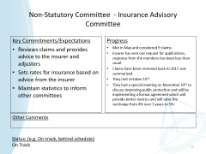
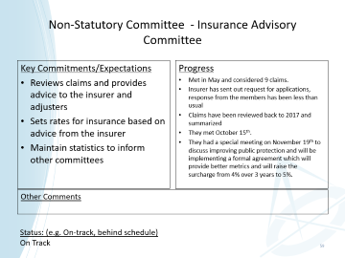
Non-Statutory Committee - Archival and Historical Committee
Key Commitments/Expectations
Catalogues, displays, maintains, repairs, accepts and/or purchases archival equipment, documents, photographs and survey artifacts.
Prepares and collects historical information about the Association and its member.
Researches related matters and answers relevant, public inquiries.
Progress
The Committee had its first meeting of 2021 on Wednesday, January 6, 2021. It has to be noted that attendance appears to be negatively affected by the Covid 19. The physical meeting of members is a stimulus to attend meetings and the longer patrons are requested to limit gatherings, the more difficult it will become to re-establish attendance. This is the opinion of only the Chair.
Other Comments
The Committee will attempt to hold at least the number of recorded meetings of previous years and that should be seven. As the attendance is reduced by the effect of the virus, our list of completed and new projects will certainly suffer negatively.
Status: (e.g. On-track, behind schedule)
Somewhat on Track

Slide 60
Non-Statutory Committee - Insurance Advisory Committee
Key Commitments/Expectations
Reviews claims and provides advice to the insurer and adjusters
Sets rates for insurance based on advice from the insurer
Maintain statistics to inform other committees
Progress
Met in May and considered 9 claims.
Insurer has sent out request for applications, response from the members has been less than usual
Claims have been reviewed back to 2017 and summarized
They met October 15th.
They had a special meeting on November 19th to discuss improving public protection and will be implementing a formal agreement which will provide better metrics and will raise the surcharge from 4% over 3 years to 5%.
Other Comments
Status: (e.g. On-track, behind schedule)
On Track

